Slide 1
EECE 5642 project proposal Music Virtualization (Demo Design)
002839146 Yifan Wang
002839771 Qiwen Ding
002697053 Shuyue Li
Notes:
The paper most related to visualization, because this paper aim to use the network to learn the layout and ui, which are kinds of virtualization.

Slide 2
Overview of Presentation
Introduction (Task & Motivation)
Related Works
Method & Visualization techniques
Challenges
Data
Expect Result

Slide 3
Introduction (Task & Motivation)
Enhancing the music experience
Non-professional Music analysis for common people
Use virtual effects and animations to enhance live performance effects
Try to convert .wav files into muti-tracks animations

Slide 4
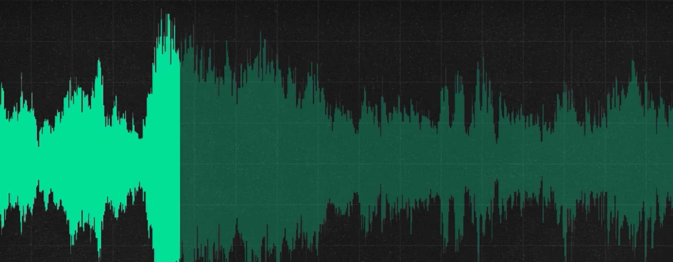
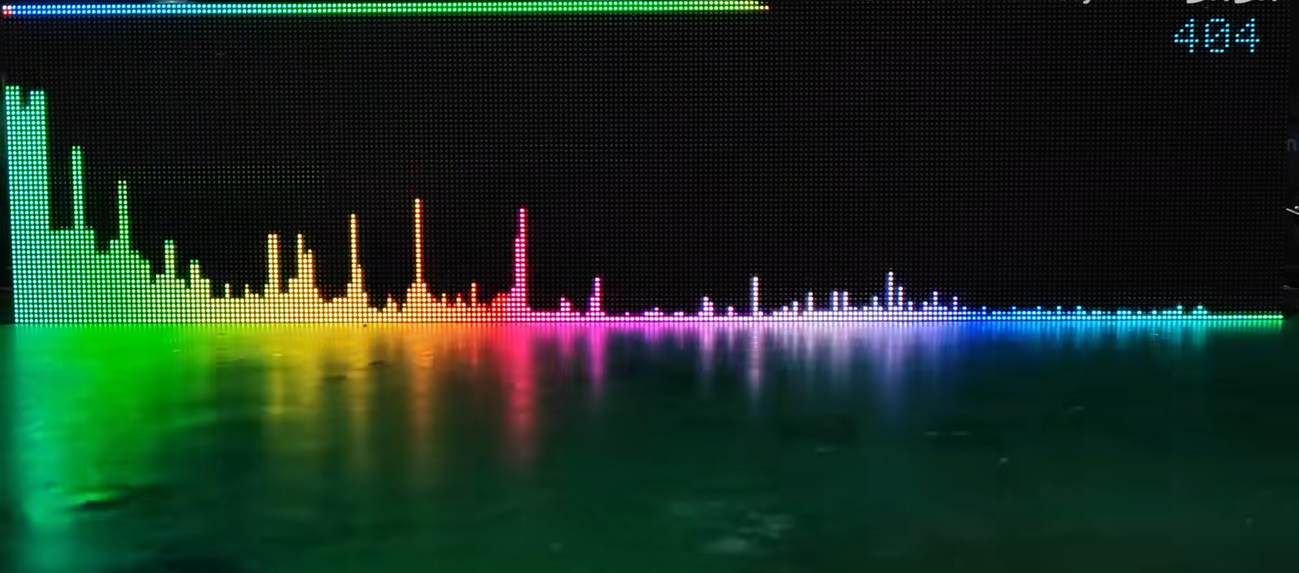
Related Works and Background
Original wave form
Virtualization through FFT

Slide 5
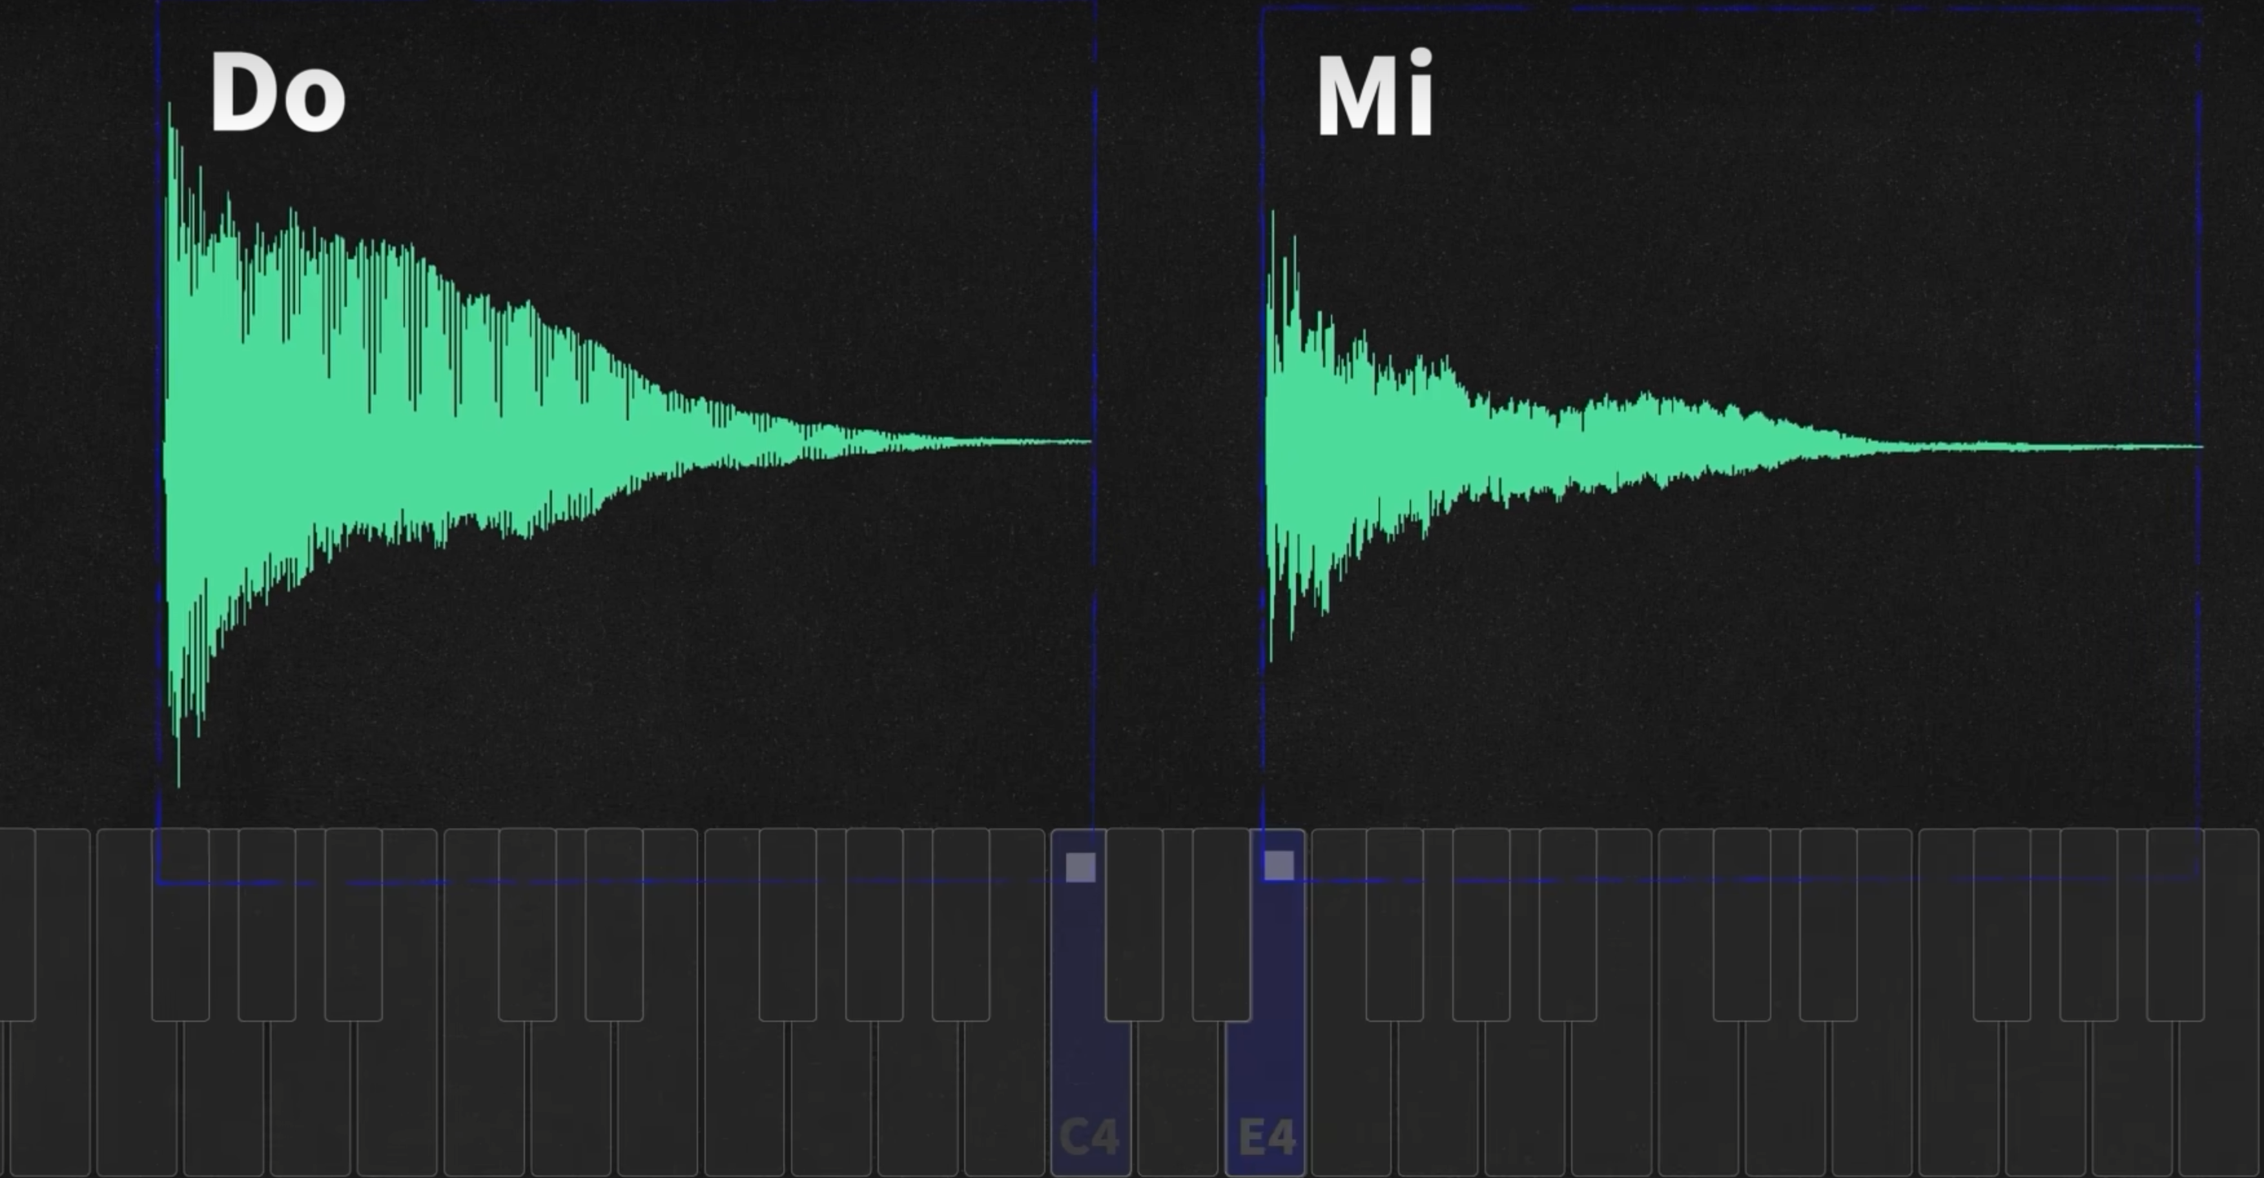
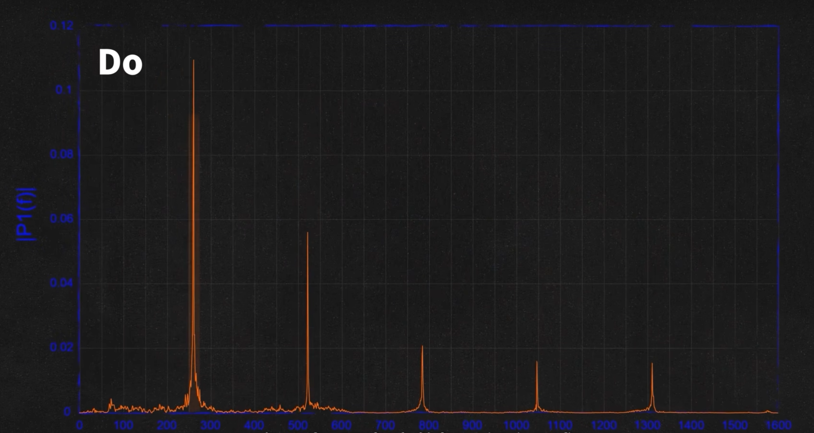
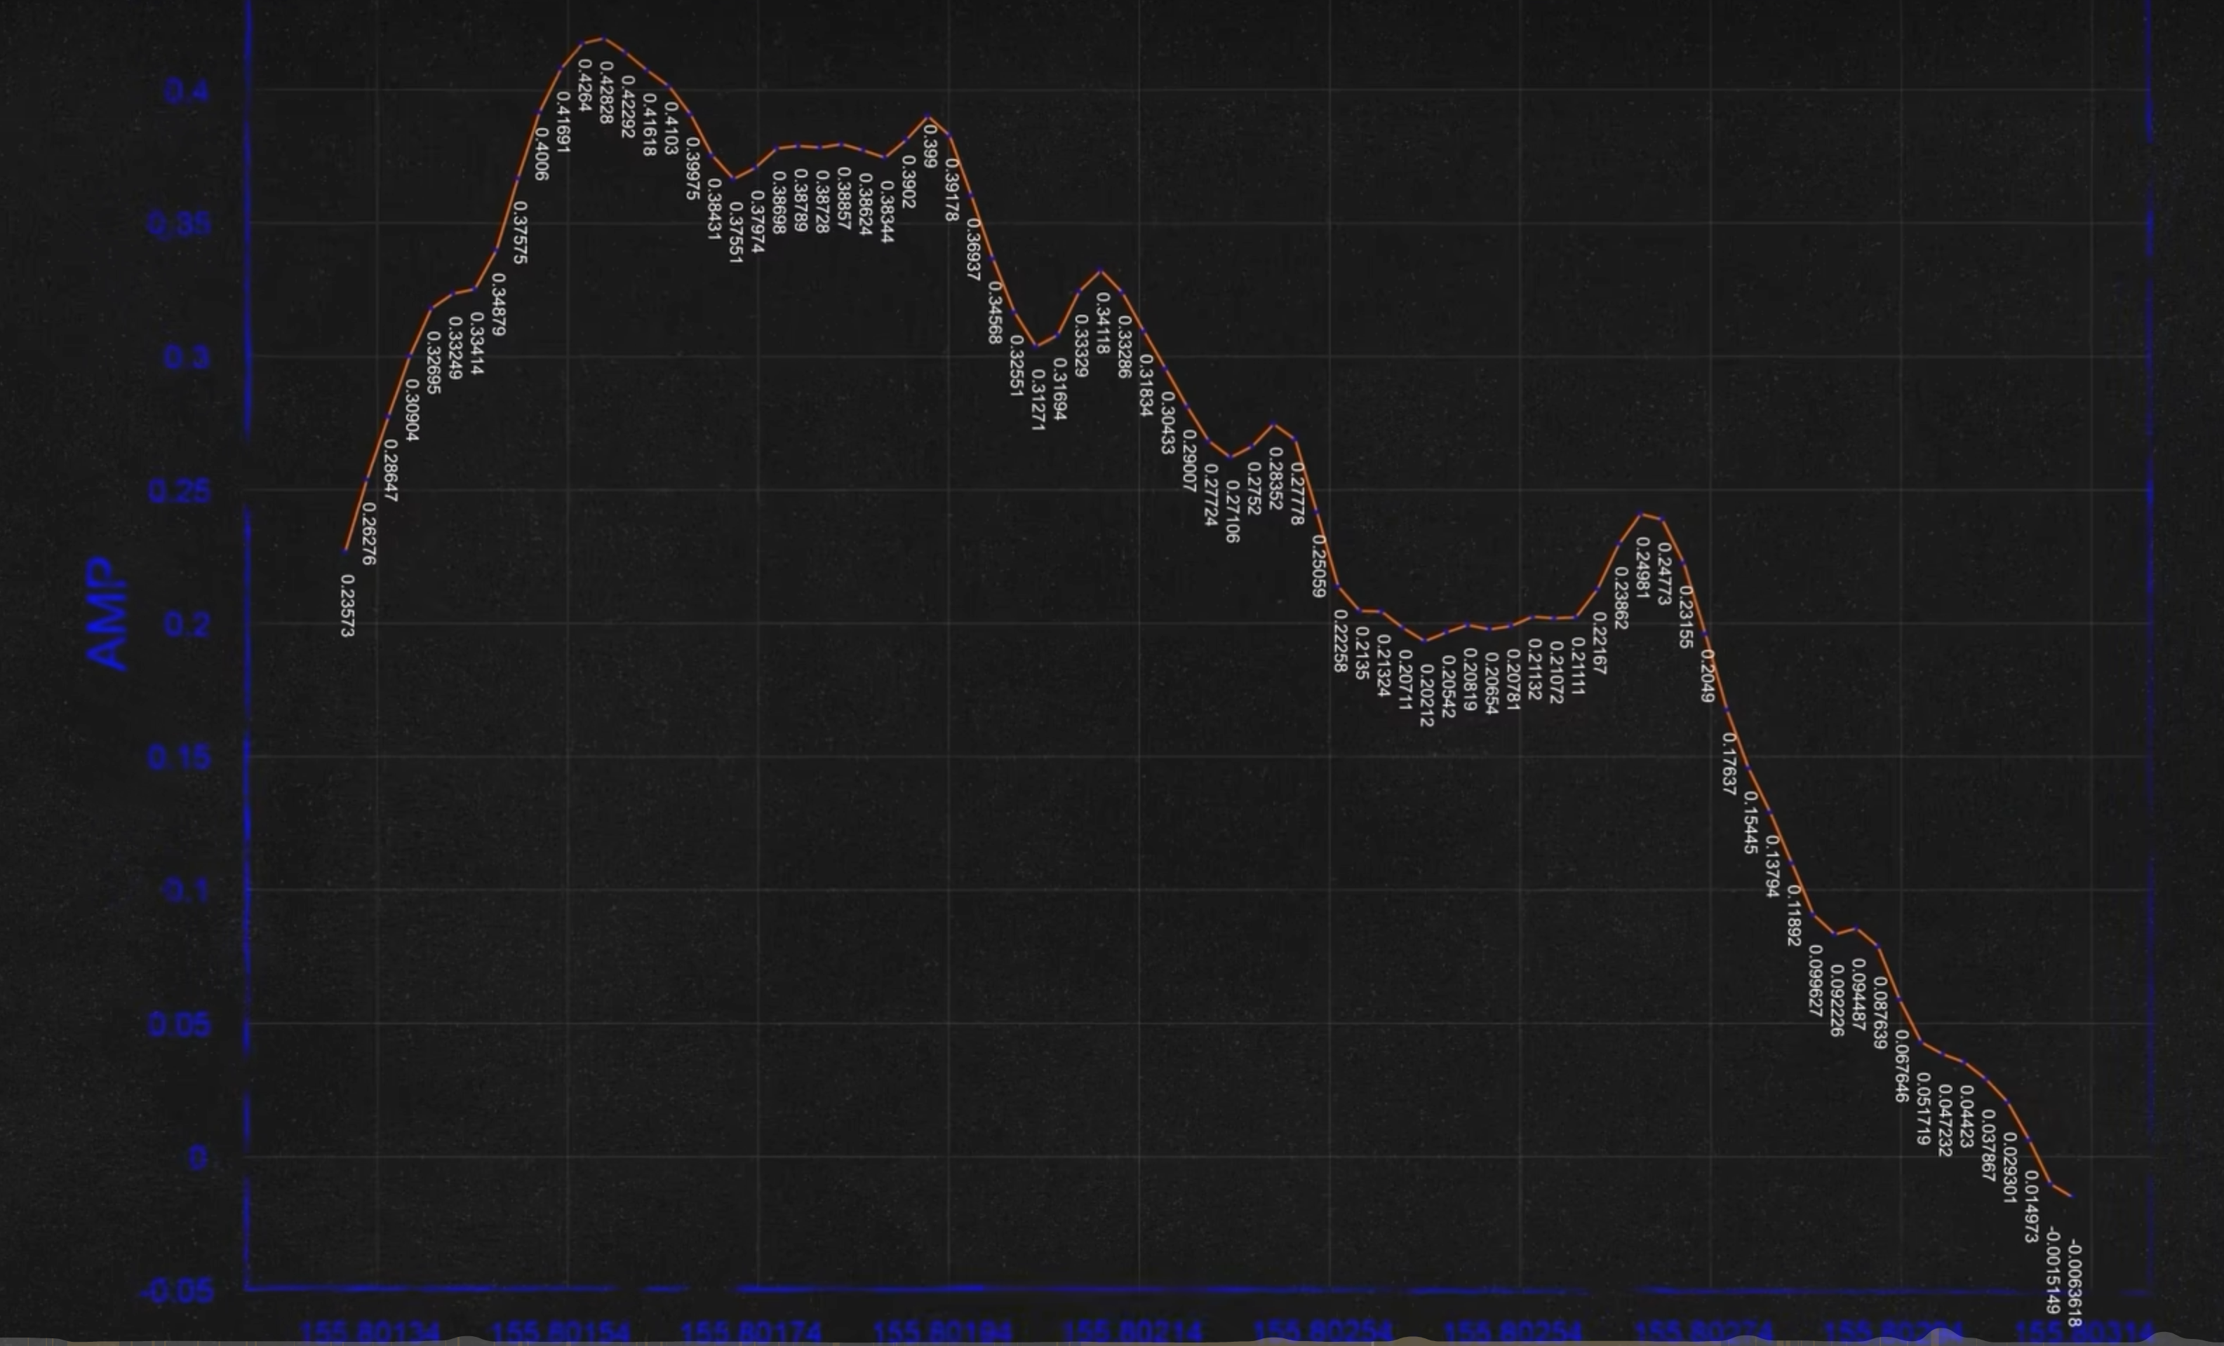
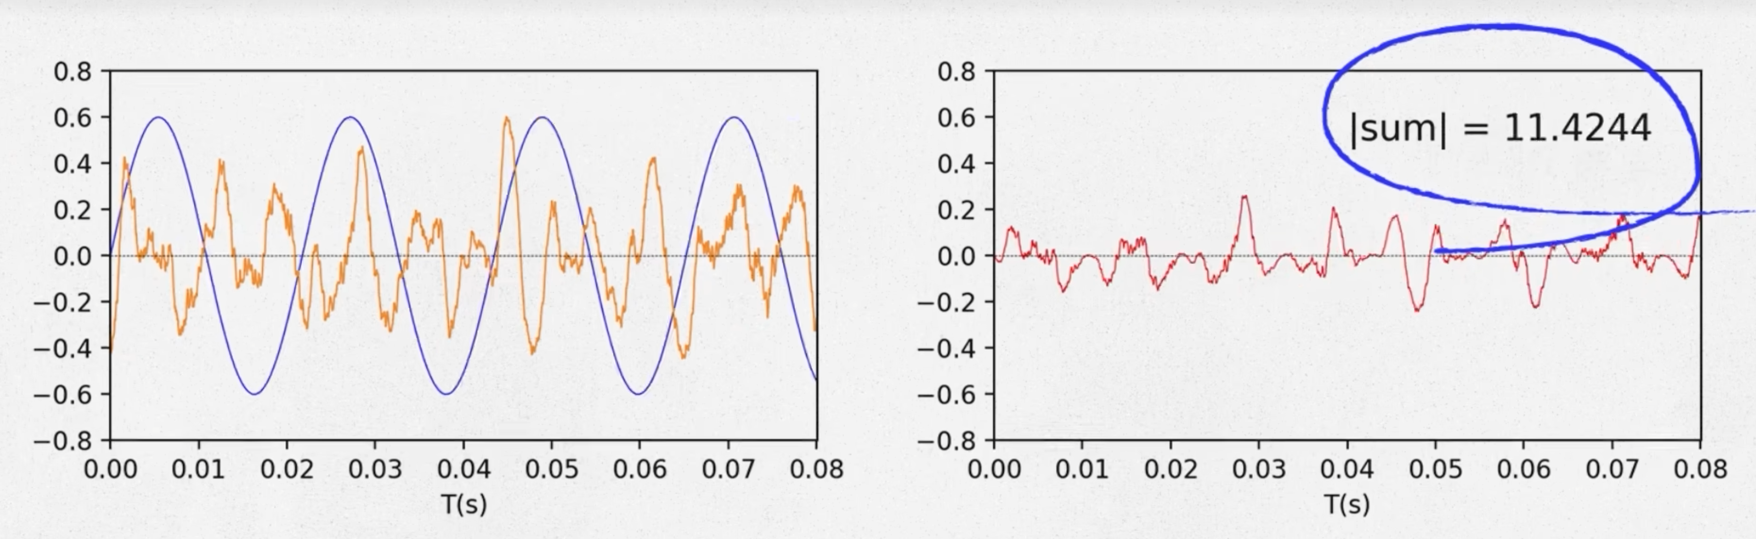
compose
We create 20000 Frequencies, and we multiply each of them with every collected points in the song. Then, we can use the sum of the result to find out wich frequency is much more important in this 0.001s period.
0.001s of a song

Slide 6
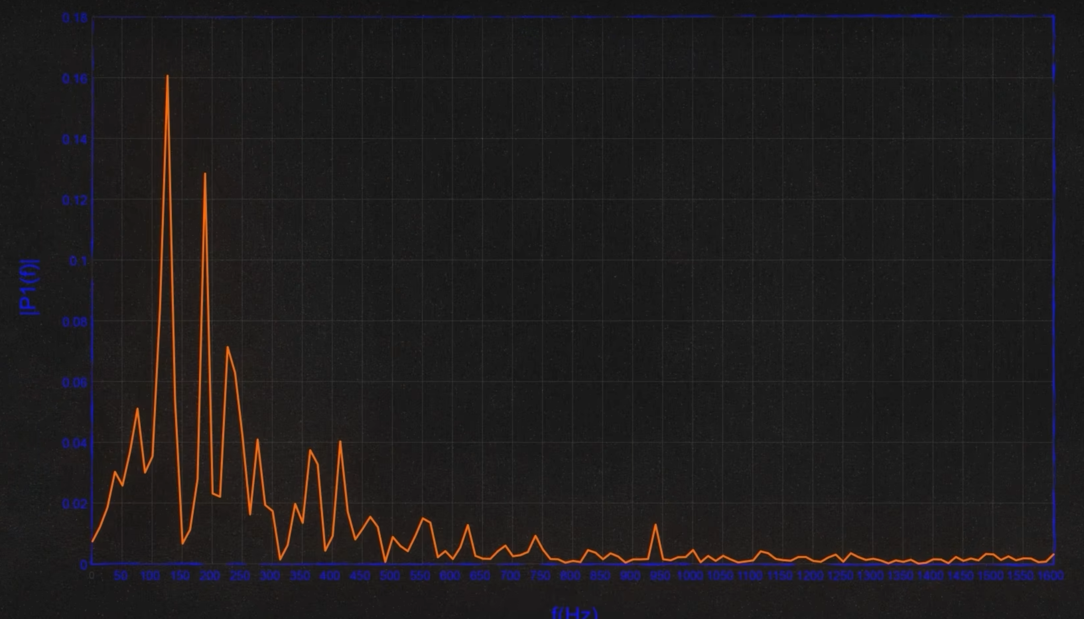
virtualize
The distribution of components of a sound wave across 20,000 frequencies.
What we are going to do:
Spectral Analysis: Analyzing the frequency spectrum of the frequency domain representation to identify frequency components associated with drum beats. Typically, drum beats generate stronger energy in the lower frequency range.
Extraction of Drum Signals: Based on the spectral analysis results, selecting frequency components related to drum beats and extracting them.

Slide 7

Method & Visualization
Extract each tracks in the songs
Use FFT to each tracks to find the beats of each tracks
Use Adobe After Effects to make animations for each tracks

Slide 8
AE
Goal: Create an audio visual video that transforms the selected piece of music into a dynamic visual representation to enhance the audience's auditory experience.
Basic setup: The video will be produced at 1080p resolution, with a frame rate of 30FPS, and the total duration matches the length of the track.
Expected effect: Dynamically adjust the size, color, and form of visual elements according to the rhythm and frequency of the music.
The project will start with track analysis to identify the key rhythm points and energy peaks of the music, then design visual elements based on this data, followed by animation, and finally rendering and post-processing.

Slide 9
Animation and effects
Use the rhythm of audio to emit particles, driving the rate and speed of particle emission.
The frequency spectrum of the audio is converted into a numerical value, which is implemented with the FreqReact script. We plan to use the following particle plugins:
Optical Flares
Particular
Shine
Uni.Glow
Gradient Ramp

Slide 10
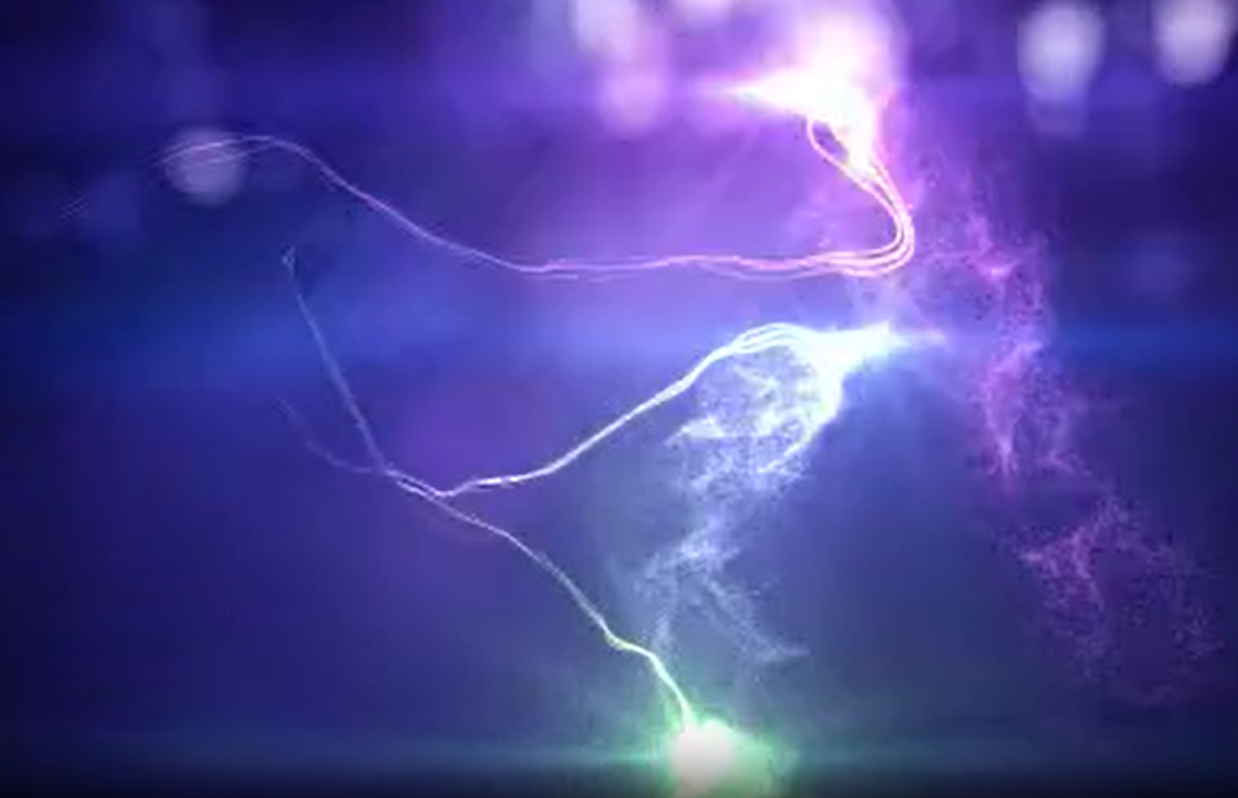
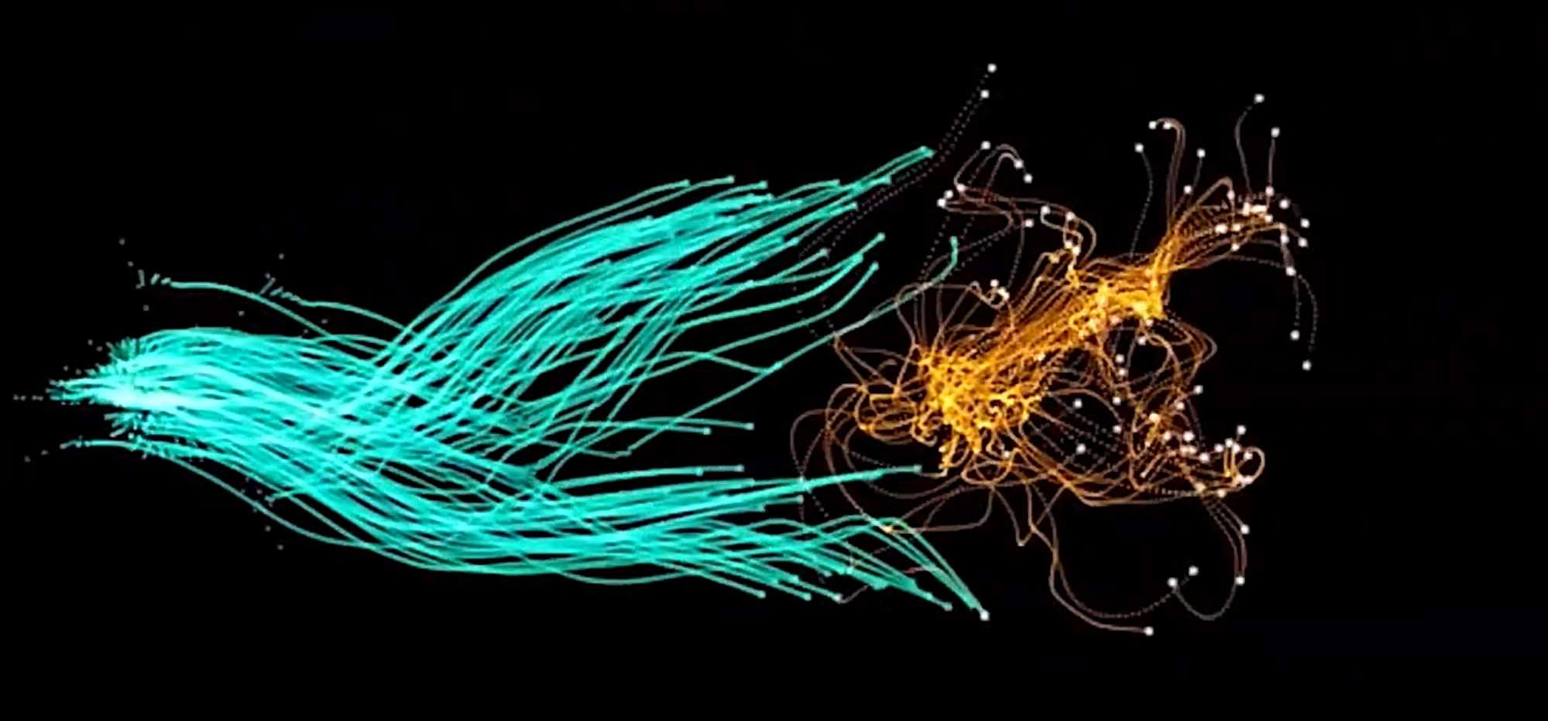

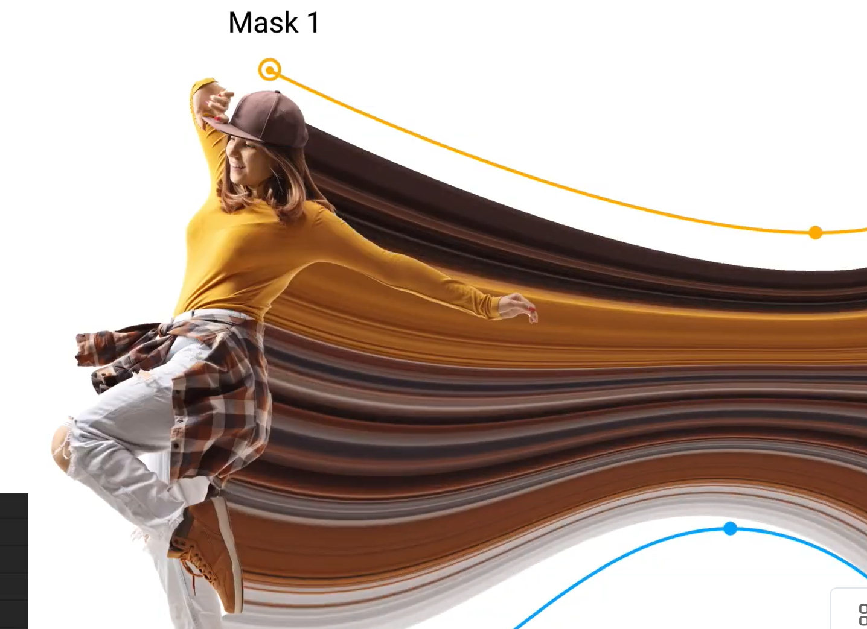

Slide 11
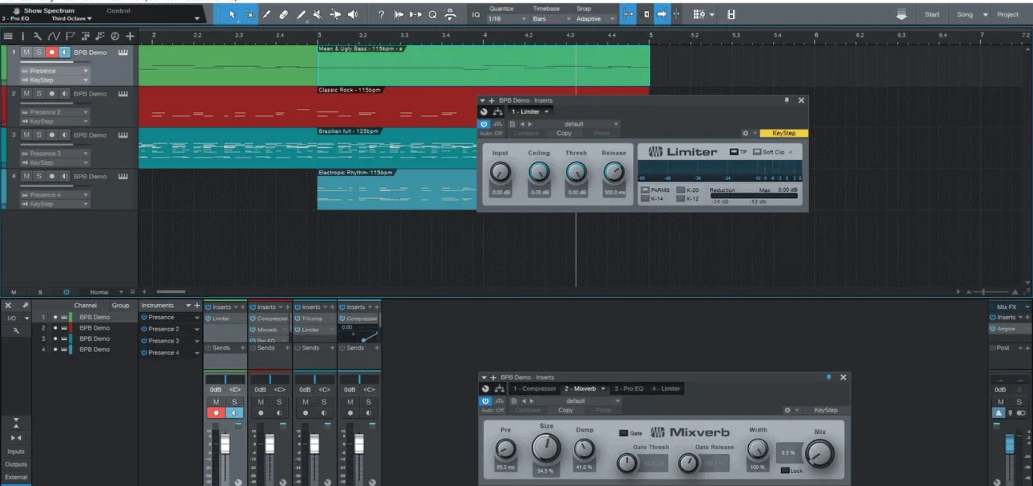
Challenges for extracting audio tracks
It’s very difficult to directly divide each track from a .wav files.
The track only can be found in original midi engineering file of the music, but we want to direct extract the tracks from .wav (or mp3) files.

Slide 12
Challenges for using AE
Complexity & Control: Creating particle effects in AE is technically demanding and requires fine-tuning multiple parameters.
Performance & Rendering: Large particle effects can reduce computer performance, necessitating a balance between quality and rendering speed.
Realism: Achieving natural and realistic particle effects demands a deep understanding of physics and environmental simulation.
Scene Interaction: Particles must accurately interact with scene elements to ensure design consistency.
Notes:
在Adobe After Effects中制作粒子效果的难点可能包括以下几个方面：
1. **复杂性和控制性：** 粒子效果通常涉及大量的粒子，每个粒子都有其自身的属性和行为。在创建和调整粒子系统时，需要理解和掌握各种参数，如粒子速度、大小、生命周期、发射器形状等，以及粒子之间的相互作用。这需要较高的技术水平和耐心来实现所需的效果，并确保粒子系统的行为符合设计目标。
2. **性能和渲染时间：** 大规模的粒子系统可能会对计算机的性能产生较大的负担，并导致渲染时间延长。因此，在设计和调整粒子效果时，需要权衡效果质量和性能要求，以确保动画的流畅性和渲染效率。
3. **粒子行为的自然性和逼真度：** 为了使粒子效果看起来自然和逼真，需要深入理解粒子系统的物理特性和行为规律，如重力、摩擦、空气阻力等。同时，还需要考虑如何模拟特定的环境条件和场景效果，如火焰、烟雾、水花等，以使粒子效果更加逼真。
4. **粒子与场景的交互：** 在动画制作中，粒子通常需要与其他元素或场景进行交互，如与文字、图形、背景等进行融合或碰撞。这需要对粒子系统的位置、运动路径和动态效果进行精确控制，以确保粒子与场景的交互效果符合设计要求。
克服这些难点需要经验丰富的动画师和设计师，他们熟悉粒子效果的原理和技术，并具有解决问题和创造高质量动画的能力。

Slide 13
Challenges for FFT
Frequency Resolution: If FFT isn't set up right, it might not catch quick changes in music, leading to mistakes in finding the beat.
Time-Frequency Match: Just because we see certain frequencies doesn't mean we can easily spot the rhythm.
Complex Rhythms: FFT has trouble with music that has a lot going on, making it hard to figure out the beat.
Noise: Background noise can cause FFT to make errors in rhythm detection.
Notes:
是的，使用FFT（快速傅里叶变换）进行音频节奏识别时可能会出现误差，导致节奏不准确。FFT是一种频域分析方法，它将时域的音频信号转换为频域表示，从而允许我们分析音频信号的频谱特征。然而，FFT有一些局限性，可能导致节奏识别不够精确，其中包括：
1. **频率分辨率：** FFT的频率分辨率受到采样率和窗口大小的限制。如果采样率不够高或窗口大小不够大，可能无法准确捕获音频信号中的快速变化，导致节奏识别不准确。
2. **时域和频域的不精确对应：** 音频信号的时域和频域之间不是简单的一一对应关系。即使在频域中观察到特定频率成分的出现，也不一定意味着在时域中存在明显的节奏或节拍。
3. **复杂节奏的处理困难：** 对于包含多个乐器和复杂节奏的音频，FFT可能无法准确地分离各个乐器的频率成分，导致难以确定整体节奏。
4. **信噪比：** 音频信号中的噪音可能会干扰FFT的结果，导致节奏识别出现误差。
为了克服这些问题，通常需要结合其他技术和方法，例如使用时域分析方法（如自相关函数、短时傅里叶变换等）、机器学习算法或者人工智能模型来提高节奏识别的准确性。此外，对于特定类型的音乐和节奏，还可以使用专门设计的算法和工具来进行节奏分析和识别，以提高准确性和效果。

Slide 14
Data
Song Selection:
Electronic: To present dynamic rhythms and rich electronic timbres.
Classical: To showcase complex harmonies and melodic lines.
Pop: To reflect trends and characteristics of modern pop music.
Data Processing:
Frequency Extraction: Utilizing Fourier Transform (FFT) to analyze each song and extract key frequencies as the data foundation.
All selected music will be in WAV format to ensure high-quality audio data for analysis.
Uniform Sampling Rate: 44100Hz, to maintain consistency and accuracy in data processing.

Slide 15
Expected Result
Transform frequency data into intuitive visual representations through visualization techniques, allowing the audience to "see" the rhythm and stylistic differences in music.
Enhance understanding of the frequency characteristics of different music styles and delve deeper into the possibilities of music visualization.

